Slide 1

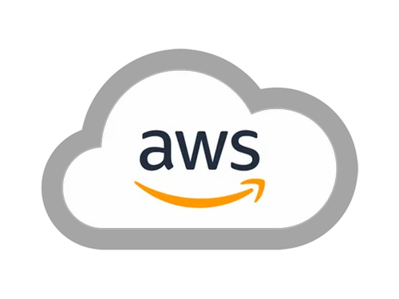
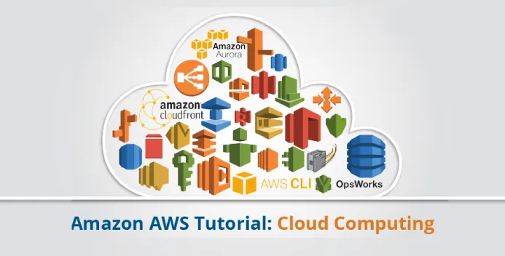
ZENVPC
Virtual Private Cloud (VPC) Deployment Using AWS
This presentation explores the innovative features and advantages of a novel VPC deployment approach using AWS, highlighting its impact, scalability, and security.

Slide 2

Challenges of Standard VPCs
Security Concerns
Scalability Issues
Performance Bottlenecks
Traditional VPCs often struggle with complex security configurations, making it difficult to manage and enforce access control policies.
Standard VPCs can encounter bottlenecks during peak usage, impacting application performance and user experience.
Limited bandwidth and network optimization can lead to increased latency and slower data transfer, affecting user interactions.

Slide 3
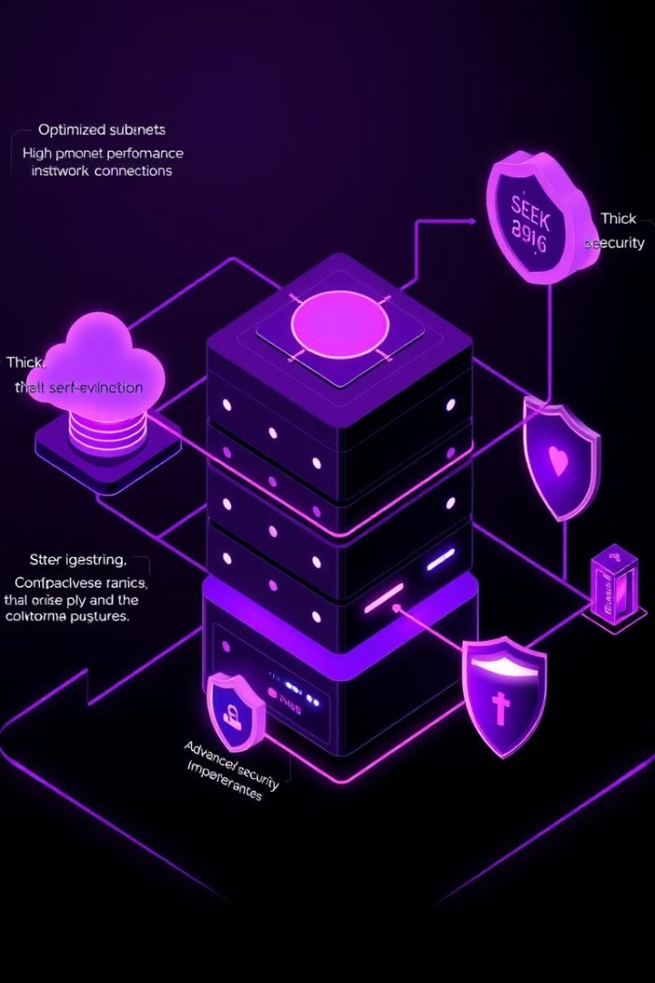
Introducing Our Unique VPC Solution
Simplified Security
Enhanced Scalability
Our solution prioritizes security by implementing a streamlined approach, ensuring robust access controls and threat prevention.
Our architecture is designed for high scalability, allowing your applications to grow seamlessly without compromising performance.
Optimized Performance
We leverage advanced network optimization techniques to minimize latency, maximize throughput, and deliver a superior user experience.

Slide 4
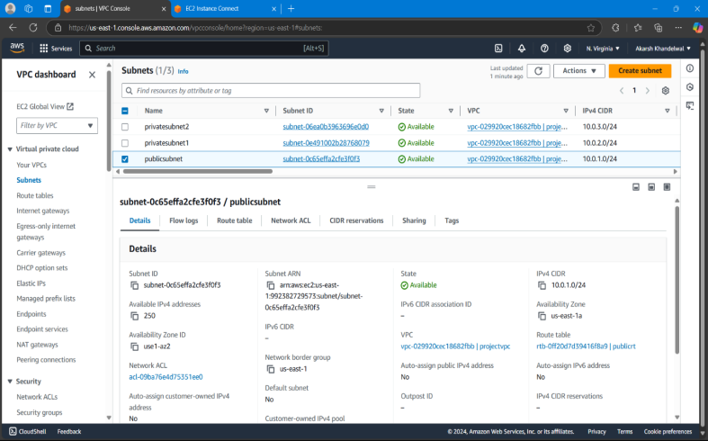
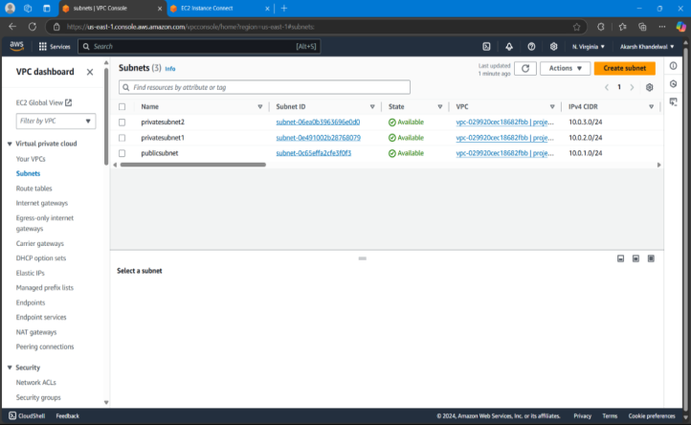
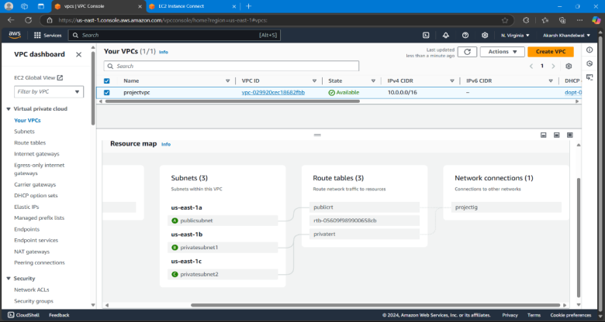



Secure Subnet Design
Public Subnet
Private Subnet
Security Groups
The public subnet houses resources that need internet access, such as load balancers and web servers.
The private subnet securely isolates sensitive data and applications, restricting access to authorized entities only.
Security groups act as firewalls, controlling inbound and outbound network traffic based on predefined rules.

Slide 5
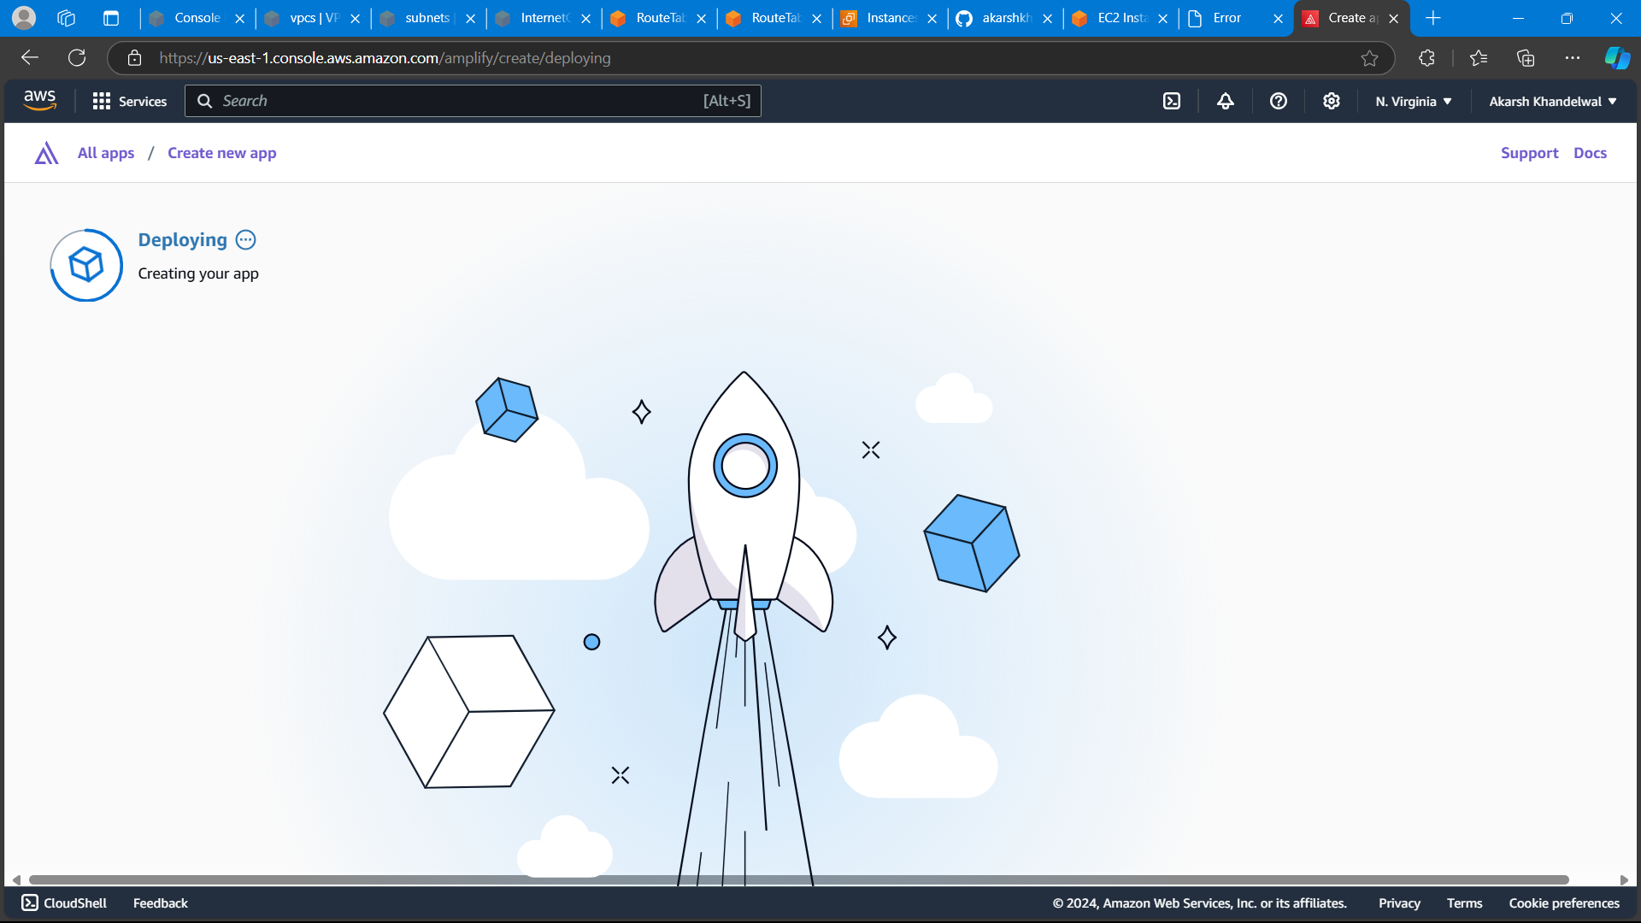
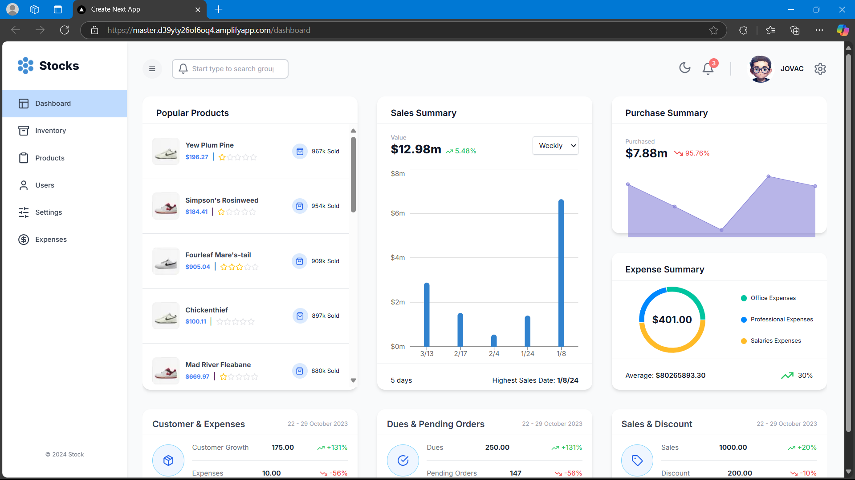
Frontend Deployment Using Amplify
Simplified Deployment
Scalability & Reliability
Amplify's seamless integration streamlines the deployment process for frontend applications, reducing complexity and time.
Amplify ensures automatic scaling of your application based on real-time demand, providing consistent performance and high availability.
Global Reach
Amplify's global infrastructure allows you to deliver your application to users around the world with minimal latency.

Slide 6



Integrating Relevant AWS Services (e.g., EC2, RDS, S3)
EC2 (Elastic Compute Cloud)
1
Provides virtual servers for running applications.
RDS (Relational Database Service)
2
Offers managed relational database instances.
S3 (Simple Storage Service)
3
Provides object storage for data and files.

Slide 7



Integrated API Gateway
API Gateway
1
Acts as a central point for managing and securing API requests, simplifying integration with backend services.
API Endpoints
2
Offers a range of endpoint options for different types of API calls, including REST, WebSocket, and HTTP APIs.
Backend Services
3
Provides seamless integration with backend resources, such as EC2 instances, Lambda functions, and RDS databases.

Slide 8
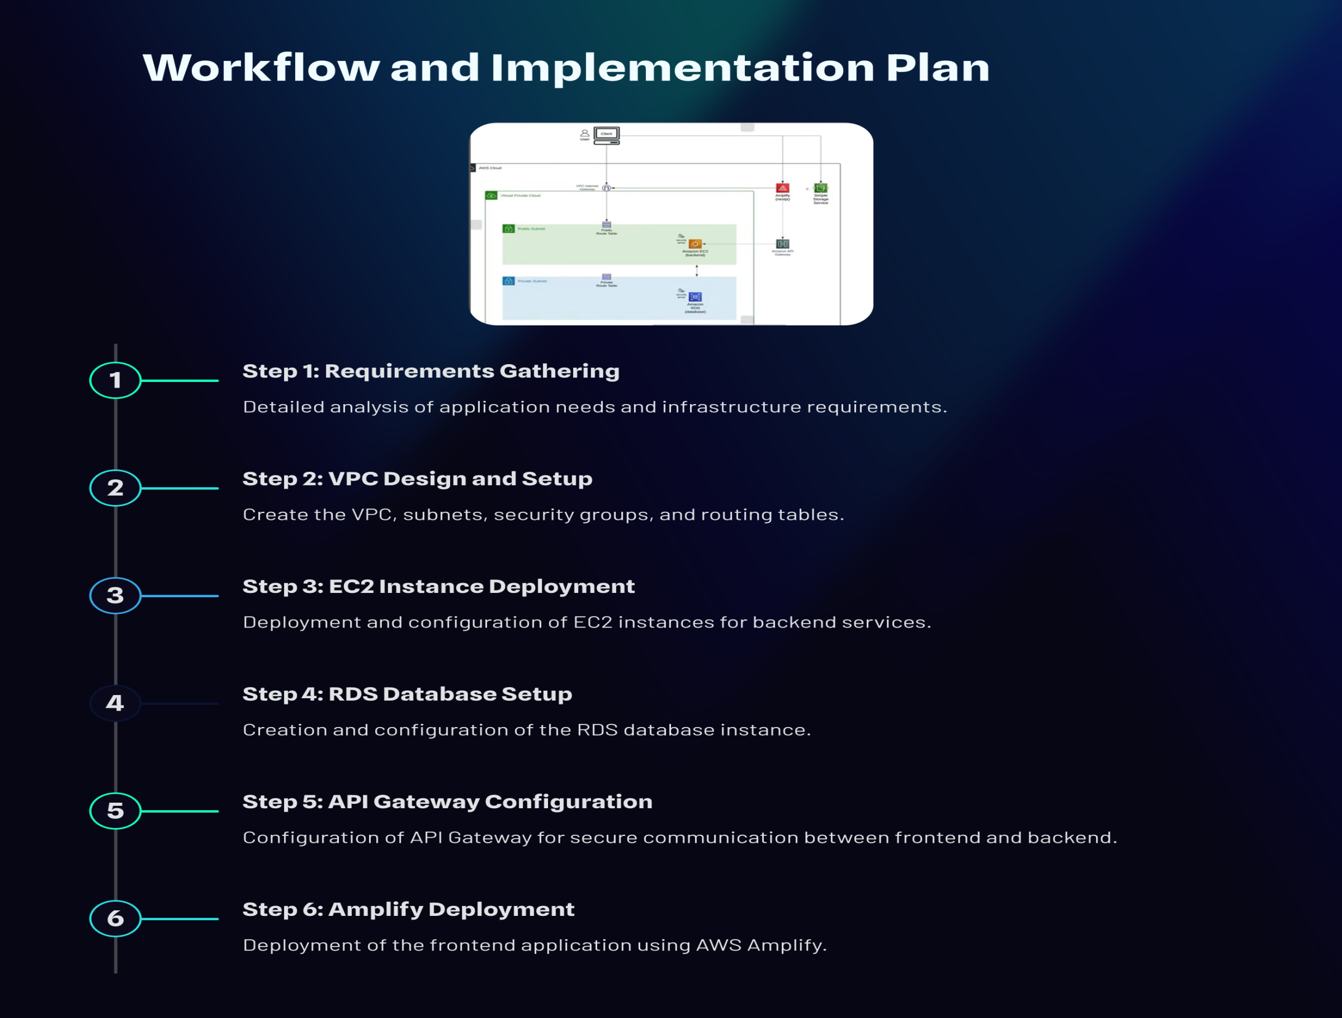

Slide 9
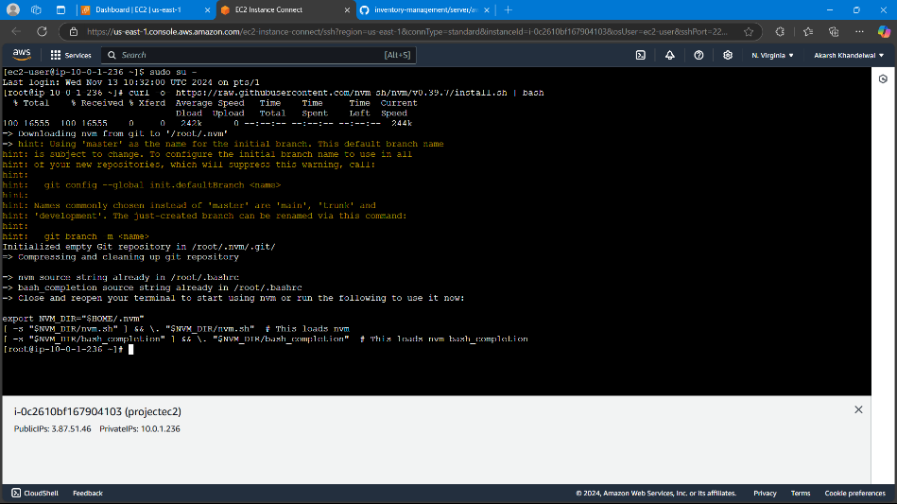
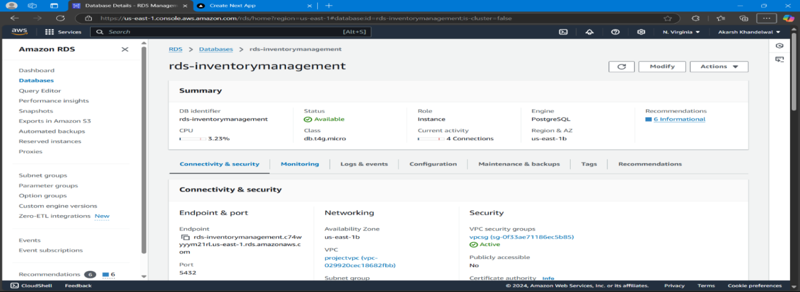
Backend Deployment Using EC2 and RDS
EC2 Instances
EC2 provides scalable and cost-effective computing resources, allowing you to run your backend application securely and efficiently.
RDS Databases
RDS offers reliable and fully managed databases, simplifying database management and ensuring data integrity and security.

Slide 10



RDS Database Integration
Scalability
1
RDS automatically scales resources to handle varying workloads, ensuring consistent database performance.
Security
2
Integrated security features like encryption and access control protect sensitive database information.
Availability
3
High availability features ensure continuous database operation, minimizing downtime and disruptions.

Slide 11

Real-world Data and Statistics on Cloud Adoption
80%
Cloud Market Share
The cloud market is rapidly expanding, with Amazon Web Services (AWS) holding the largest market share.
50%
Cost Savings
Organizations are seeing significant cost savings by migrating to the cloud, leveraging pay-as-you-go models.
90%
Increased Agility
Cloud adoption has allowed businesses to become more agile and responsive to changing market demands.

Slide 12




Cost-Effectiveness
Reduced Infrastructure Costs
1
Lower hardware and maintenance expenses.
Optimized Resource Utilization
2
Allocate resources efficiently.
Increased Productivity
3
Streamline workflows and improve developer efficiency.
Improved Business Outcomes
4
Enhanced security, scalability, and performance drive business growth.

Slide 13

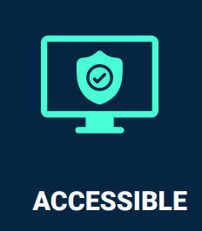
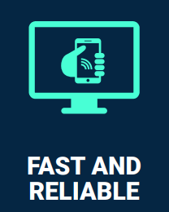
Challenges, Lessons Learned, and Future Enhancements
Security
1
Ensuring strong security measures to protect sensitive data and applications in the cloud.
Cost Optimization
2
Optimizing resource usage and implementing cost-effective solutions for long-term sustainability.
Continuous Improvement
3
Monitoring performance, identifying areas for improvement, and implementing new features and technologies.

Slide 14

Conclusion and Key Takeaways
Our innovative VPC deployment approach using AWS offers a comprehensive solution for enhancing network security, scalability, and efficiency. It empowers organizations to confidently deploy and manage their critical applications in the cloud with confidence.

Slide 15

Thank You

